Slide 1
Software Process Models/
Software Development Life Cycle Models

Slide 2
Software Process Model
Attempt to organize the software life cycle by
    defining activities involved in software production
    order of activities and their relationships
Goals of a software process model
  standardization, predictability, productivity, high product quality, ability to plan time and budget requirements

Slide 3
Code & Fix
The earliest approach
Write code
Fix it to eliminate any errors that have been detected, to enhance existing functionality, or to add new features
Source of difficulties and deficiencies
  impossible to predict
  difficult to manage

Slide 4
Why Models are needed?
Symptoms of inadequacy: the software crisis
  scheduled time and cost exceeded
  user expectations not met
  poor quality
The size and economic value of software applications required appropriate "process models"

Slide 5
Goals of Process Model
Determine the order of stages involved in software development, and to establish the transition criteria for progressing from one stage to the next.
Thus a process model addresses the following software project questions:
What shall we do next?
How long shall we continue to do it?

Slide 6
SDLC Model
A framework that describes the activities performed at each stage of a software development project.

Slide 7
Stages of Software Development
Communication
Project initiation
Requirements gathering
Planning
Estimating
Scheduling
Tracking
Construction
Code
Test
Modelling
Analysis
Design
Deployment
Delivery
Support
Feedback

Slide 8
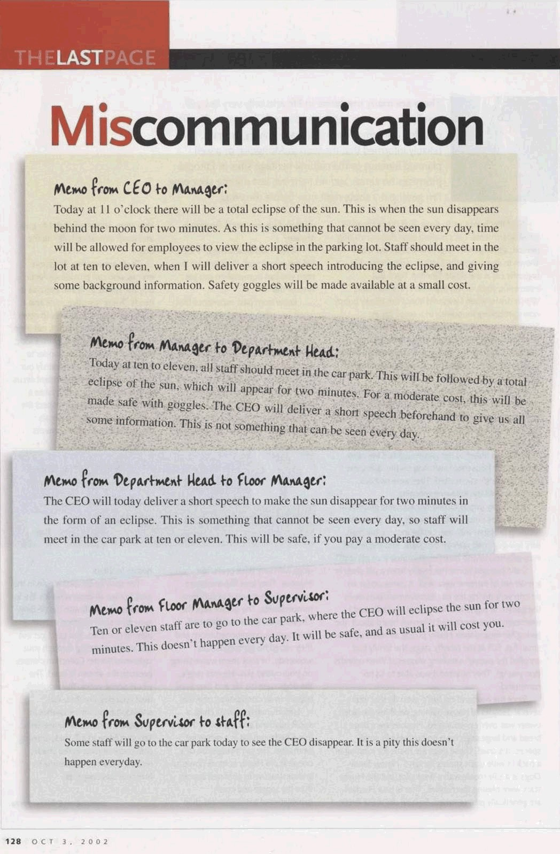

Slide 9
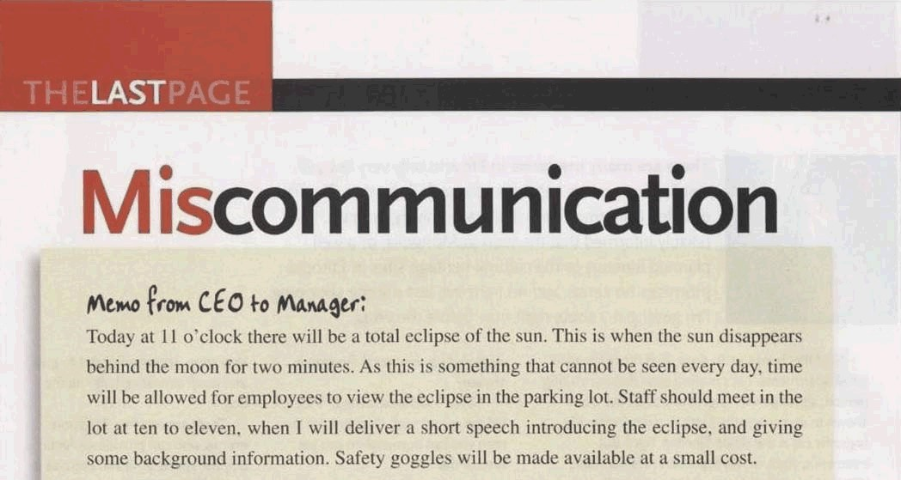

Slide 10
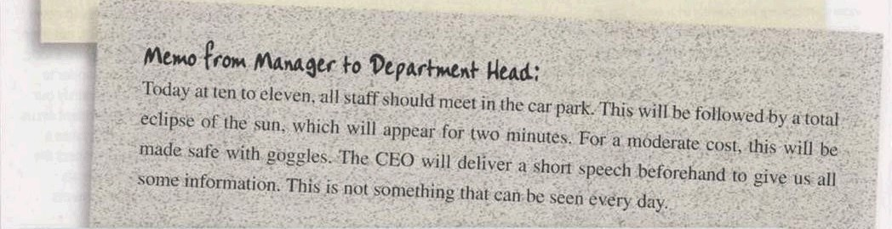

Slide 11
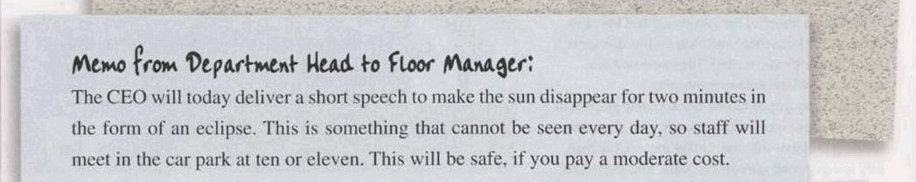

Slide 12
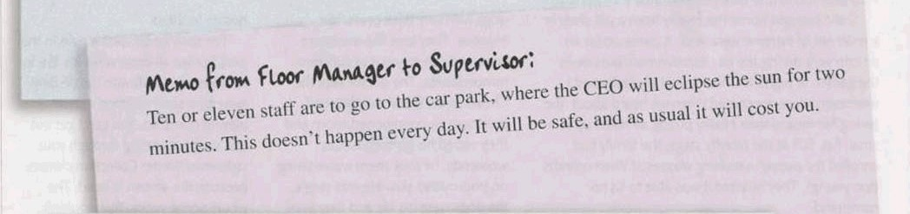

Slide 13
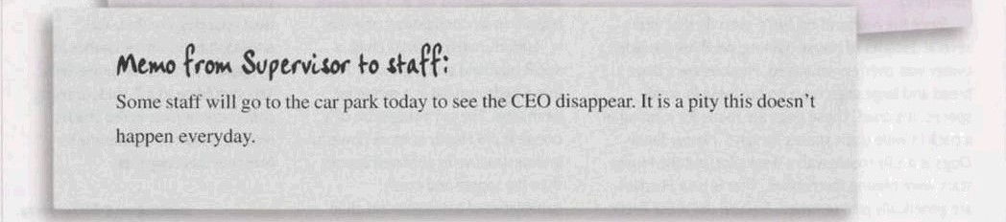

Slide 14
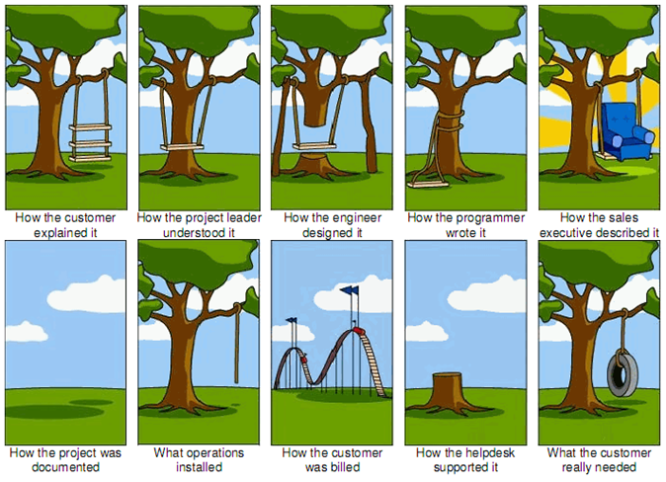

Slide 15
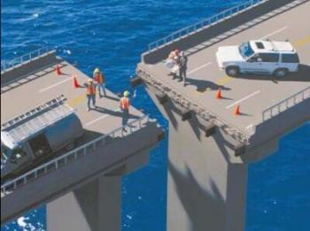
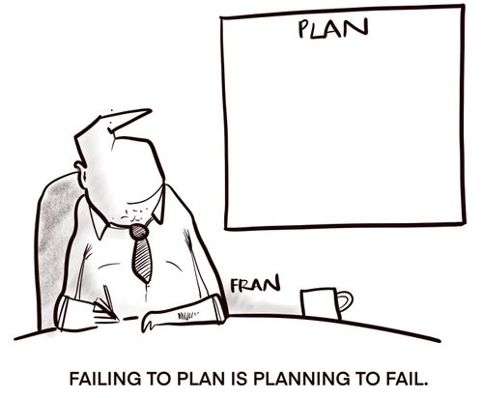

Slide 16
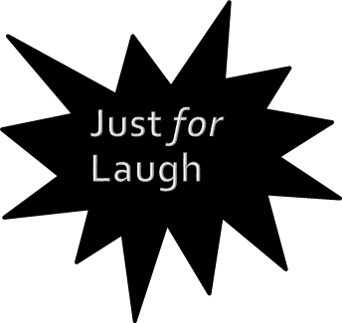
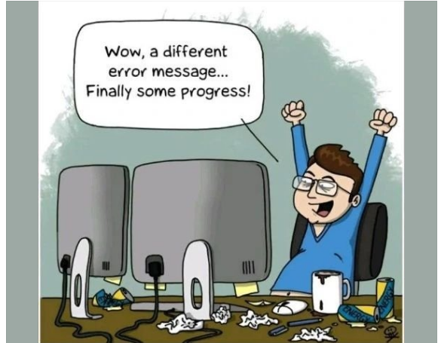

Slide 17
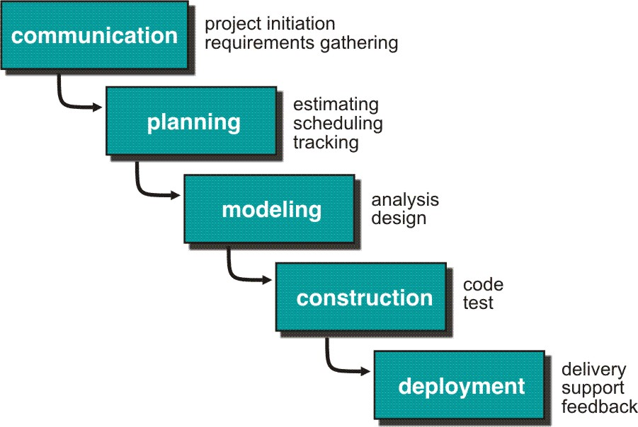
The Waterfall Model

Slide 18
Waterfall Strengths
Easy to understand, easy to use
Milestones are well understood
Requirements stability
Good for management control
Works well when quality is more important than cost or schedule

Slide 19
Waterfall Deficiencies
All requirements must be known upfront
Deliverables created for each phase are considered frozen
Integration is one big bang at the end
Little opportunity for customer to preview the system (it may be too late)

Slide 20
When to use the Waterfall Model?
Requirements are very well known
Product definition is stable
Technology is understood
New version of an existing product
Porting an existing product to a new platform.

Slide 21
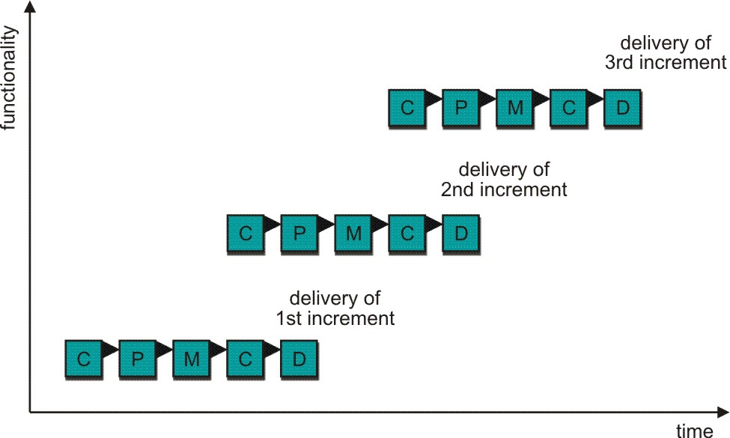
Incremental Model

Slide 22
Incremental Model Strengths
Develop high-risk or major functions first
Each increment delivers an operational product
Customer can respond to each increment
Lowers initial delivery cost
Initial product delivery is faster
Customers get important functionality early
Risk of changing requirements is reduced

Slide 23
Incremental Model Weaknesses
Requires good planning and design
Requires early definition of a complete and fully functional system to allow for the definition of increments
Well-defined module interfaces are required (some will be developed long before others)
Total cost of the complete system is not lower

Slide 24
When to use the Incremental Model?
Risk, funding, schedule, program complexity, or need for early realization of benefits.
Most of the requirements are known up-front but are expected to evolve over time
A need to get basic functionality to the market early
On projects which have lengthy development schedules
On a project with new technology

Slide 25
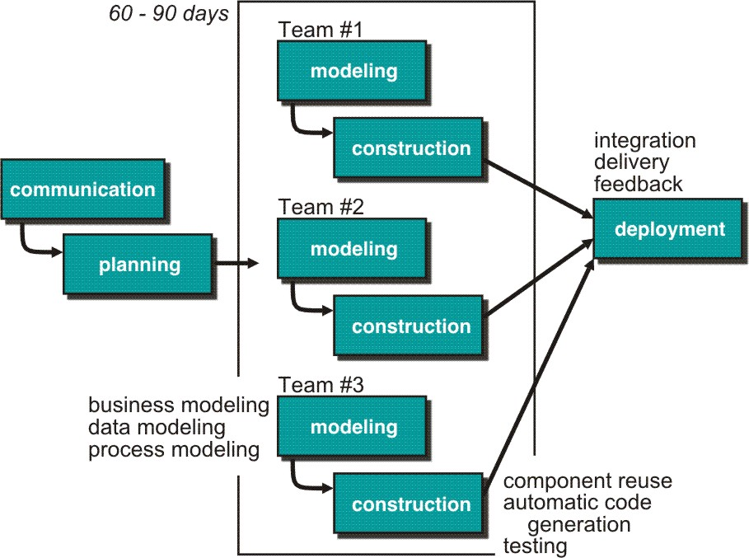
RAD Model
Rapid Application Development – RAD

Slide 26
RAD Strengths
Reduced cycle time and improved productivity with fewer people means lower costs
Time-box approach mitigates cost and schedule risk
Customer involved throughout the complete cycle minimizes risk of not achieving customer satisfaction and business needs
Notes:
imeboxing is a planning technique common in planning projects (typically for software development), where the schedule is divided into a number of separate time periods (timeboxes, normally two to six weeks long), with each part having its own deliverables, deadline and budget. Timeboxing is a core aspect of rapid application development (RAD) software development processes such as dynamic systems development method (DSDM) and agile software development.
Timeboxes are used as a form of risk management, especially for tasks that may easily extend past their deadlines. The end date (deadline) is one of the primary drivers in the planning and should not be changed as it is usually linked to a delivery date of the product. If the team exceeds the deadline, the team failed in proper planning and / or effective execution of the plan. This can be the result of: the wrong people on the wrong job (lack of communication between teams, lack of experience, lack of commitment / drive / motivation, lack of speed) or underestimation of the (complexity of the) requirements.
When the team exceeds the deadline, the following actions might be taken after conferring with the Client:
Dropping requirements of lower impact (the ones that will not be directly missed by the user)
Working overtime to compensate for the time lost
Moving the deadline

Slide 27
RAD Weaknesses
Accelerated development process must give quick responses to the user
Risk of never achieving closure
Hard to use with legacy systems
Requires a system that can be modularized
Developers and customers must be committed to rapid-fire activities in an abbreviated time frame.

Slide 28
When to use RAD?
Reasonably well-known requirements
User involved throughout the life cycle
Project can be time-boxed
Functionality delivered in increments
Low technical risks
System can be modularized

Slide 29
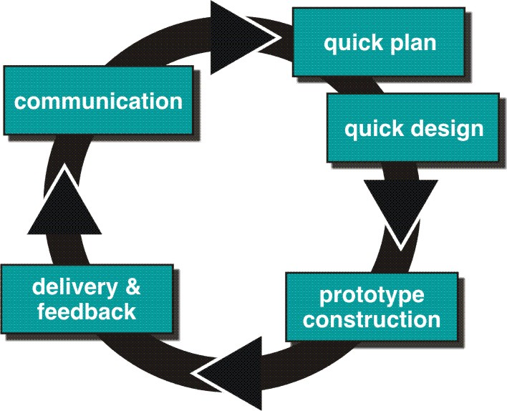
Evolutionary Models: Prototyping

Slide 30
Types of Prototyping
Throwaway Prototyping Approach
Evolutionary Prototyping Approach

Slide 31
Prototyping Strengths
Reduced time and cost
  Can improve the quality of requirements and specifications provided to developers
    Early determination of what the user really wants can result in faster and less expensive software
Improved/increased user involvement
  User can see and interact with the prototype, allowing them to provide better/more complete feedback and specs
  Misunderstandings / miscommunications revealed
  Final product more likely to satisfy their desired look / feel / performance

Slide 32
Disadvantages of prototyping
  Insufficient analysis
  Focus on limited prototype can distract developers from analyzing complete project
  Conversion of limited prototypes into poorly engineered final projects that are hard to maintain
  May not be noticed if developers too focused on building prototype as a model

Slide 33
Disadvantages of prototyping
User confusion of prototype and finished system
  Users can think that a prototype (intended to be thrown away) is actually a final system that needs to be polished.
  Unaware of the scope of programming needed to give prototype robust functionality
  Users can become attached to features included in prototype for consideration

Slide 34
Disadvantages of prototyping
Developer attachment to prototype
  If spend a great deal of time/effort to produce, may become attached
  Might try to attempt to convert a limited prototype into a final system
  Bad if the prototype does not have an appropriate underlying architecture

Slide 35
Disadvantages of prototyping
Excessive development time of the prototype
  Prototyping supposed to be done quickly.
  If developers lose sight of this, can try to build a prototype that is too complex
  For throw away prototypes, the benefits realized from the prototype (precise requirements) may not offset the time spent in developing the prototype – expected productivity reduced
  Users can be stuck in debates over prototype details and hold up development process

Slide 36
The V Model
It is an extension of the waterfall model and is based on the association of a testing phase for each corresponding development stage.
A variant of the Waterfall that emphasizes the verification and validation of the product.
This means that for every single phase in the development cycle, there is a directly associated testing phase.

Slide 37
The V Model
Testing of the product is planned & designed in parallel with a corresponding phase of development
This is a highly-disciplined model and the next phase starts only after completion of the previous phase.

Slide 38
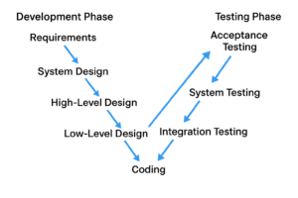

Slide 39
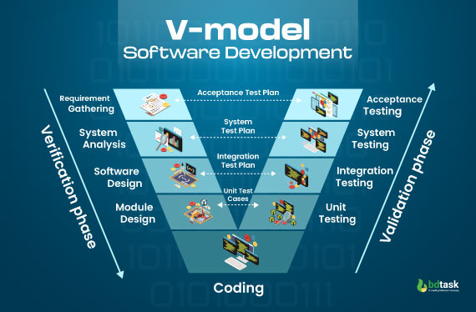

Slide 40
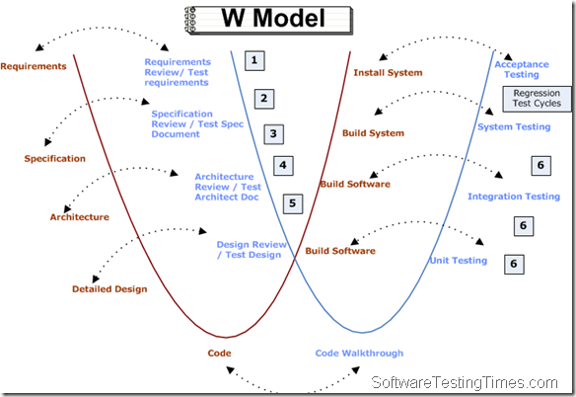

Slide 41
V-Model Strengths
Emphasize planning for verification and validation of the product in early stages of product development
Each deliverable must be testable
Project management can track progress by milestones
Easy to use

Slide 42
V-Model Weaknesses
Does not easily handle concurrent events
Does not handle iterations or phases
Does not easily handle dynamic changes in requirements
Does not contain risk analysis activities

Slide 43
When to use the V-Model?
Excellent choice for systems requiring high reliability – hospital patient control applications.
All requirements are known up-front
When it can be modified to handle changing requirements beyond analysis phase
Solution and technology are known

Slide 44
Unified Process Model
A software process that is:
  use-case driven
  architecture-centric
  iterative and incremental
Closely aligned with the Unified Modeling Language (UML)

Slide 45
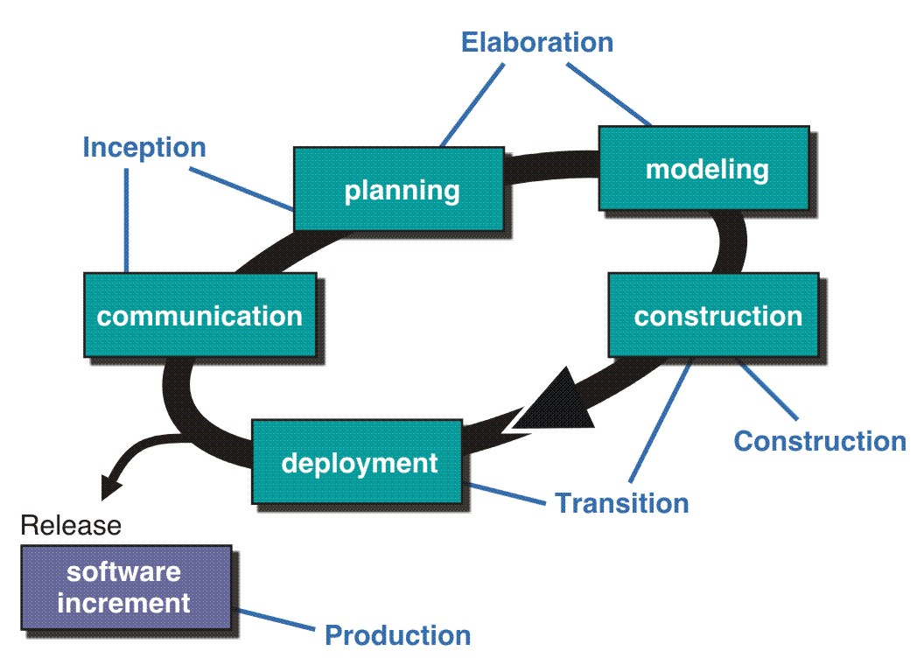
The Unified Process (UP)
inception

Slide 46
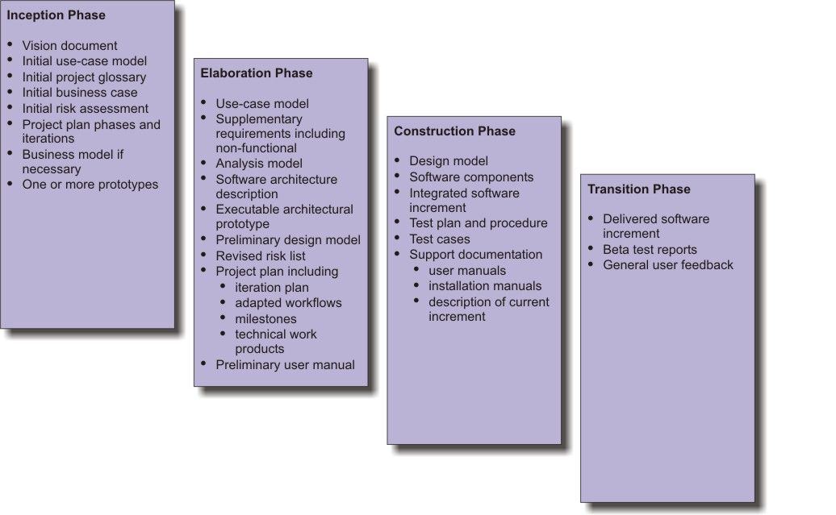
UP Work Products

Slide 47
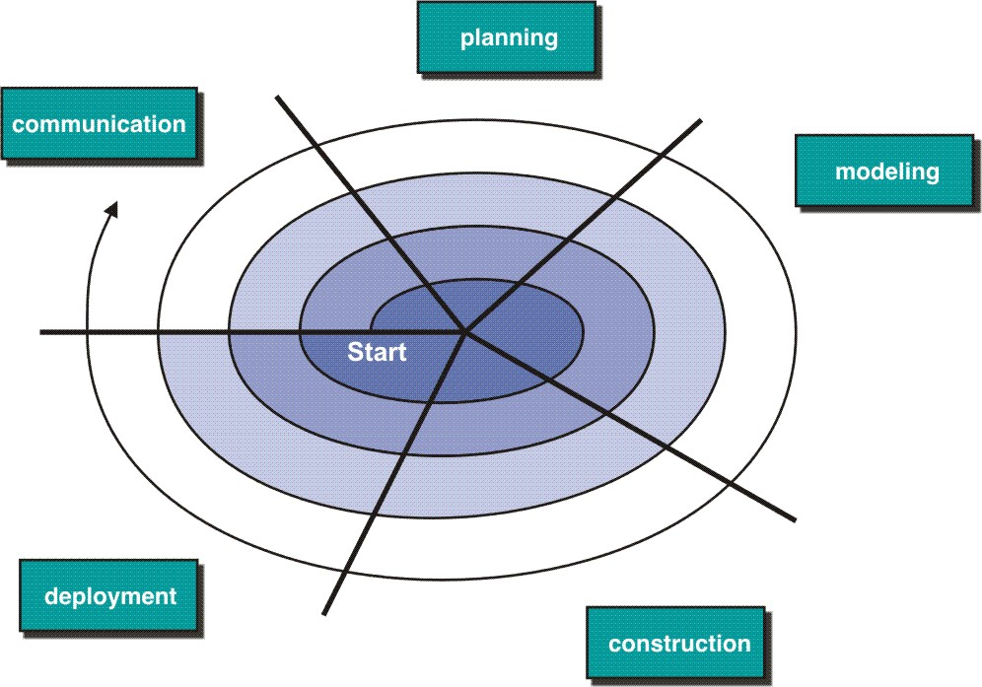
Evolutionary Models: The Spiral

Slide 48
Advantages of the Spiral Model
Risk Handling
Good for large projects
Flexibility in Requirements
Customer Satisfaction
Iterative and Incremental Approach
Emphasis on Risk Management
Improved Communication
Improved Quality

Slide 49
Key Factors to Consider to select a SDLC model
Project Size & Complexity: Small, straightforward projects suit Waterfall; large, complex ones need iterative models like Agile or Spiral.
Requirement Flexibility: If requirements are stable, Waterfall works;
Risk Tolerance: if they'll change, Agile or Iterative models are better.
High-risk projects (mission-critical) benefit from Spiral's risk analysis; low-risk can use simpler models.
Client Involvement: Constant feedback needs Agile/Prototype; minimal input suits Waterfall/V-Model.
Timeline & Budget: Agile offers variable budgets for changing needs; Waterfall suits fixed budgets/timelines.
Team Expertise & Size: Experienced teams can handle Agile; smaller teams might prefer simpler, linear models.
Quality & Testing Needs: For high reliability and rigorous testing, the V-Model is ideal.

Slide 50
Common Models & Their Fit:
Waterfall: Small, well-defined projects with fixed requirements.
Agile/Scrum: Large, complex, changing requirements, high client collaboration.
Spiral: Large, high-risk, complex projects needing risk mitigation.
V-Model: Projects needing high reliability and rigorous testing/validation.
Iterative/Incremental: Delivering in parts, refining over time.

Slide 51
Conclusion
Different life-cycle models
Each with own strengths
Each with own weaknesses
Criteria for deciding on a model include
  The organization
  Its management
  Skills of the employees
  The nature of the product
Best suggestion
  “Mix-and-match” life-cycle model

